Slide 1




Collaborative
Farming
Tushar Amol Gaikwad

Slide 2



Contents
03/
Objective
05/
Benefits of Platform
01/
Introduction
04/
Proposed
Solution
02/
Problem Statement

Slide 3

Introduction
The Collaborative Farming project is a web-based platform designed to bridge the gap between non-professional farmers, farmers, and agricultural service providers. It aims to optimize land utilization by enabling land leasing and rentals while also providing easy access to agricultural services and government schemes. By leveraging technology, the platform enhances collaboration, reduces operational challenges, and promotes sustainable farming practices.
Unlike traditional agricultural platforms, this system does not include crop selling, a marketplace, or community features. Instead, it focuses solely on connecting stakeholders for land utilization and service access, ensuring transparency and efficiency in the farming ecosystem.

Slide 4
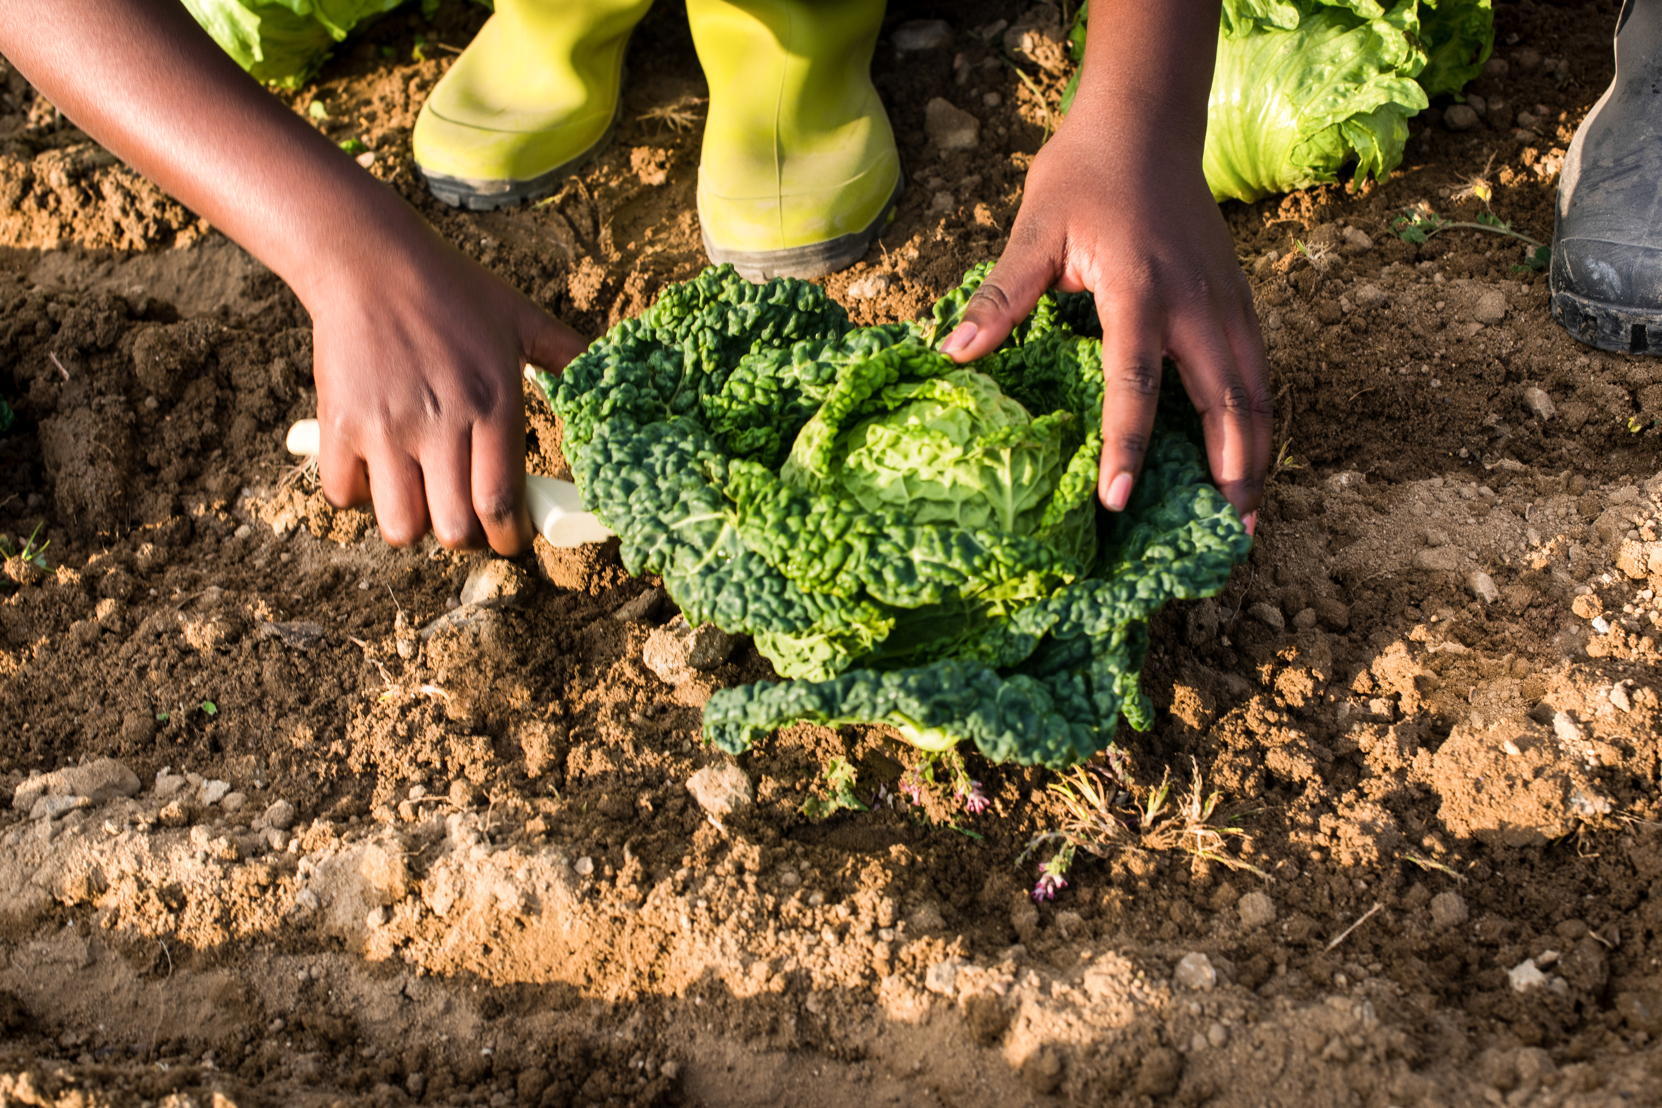
Problem Statement
1. Underutilization of Agricultural Land –
2. Limited Access to Agricultural Services –
3. Lack of Awareness About Government Schemes –
4. Fragmented Collaboration in Agriculture –
5. Complex Land Leasing Process –

Slide 5
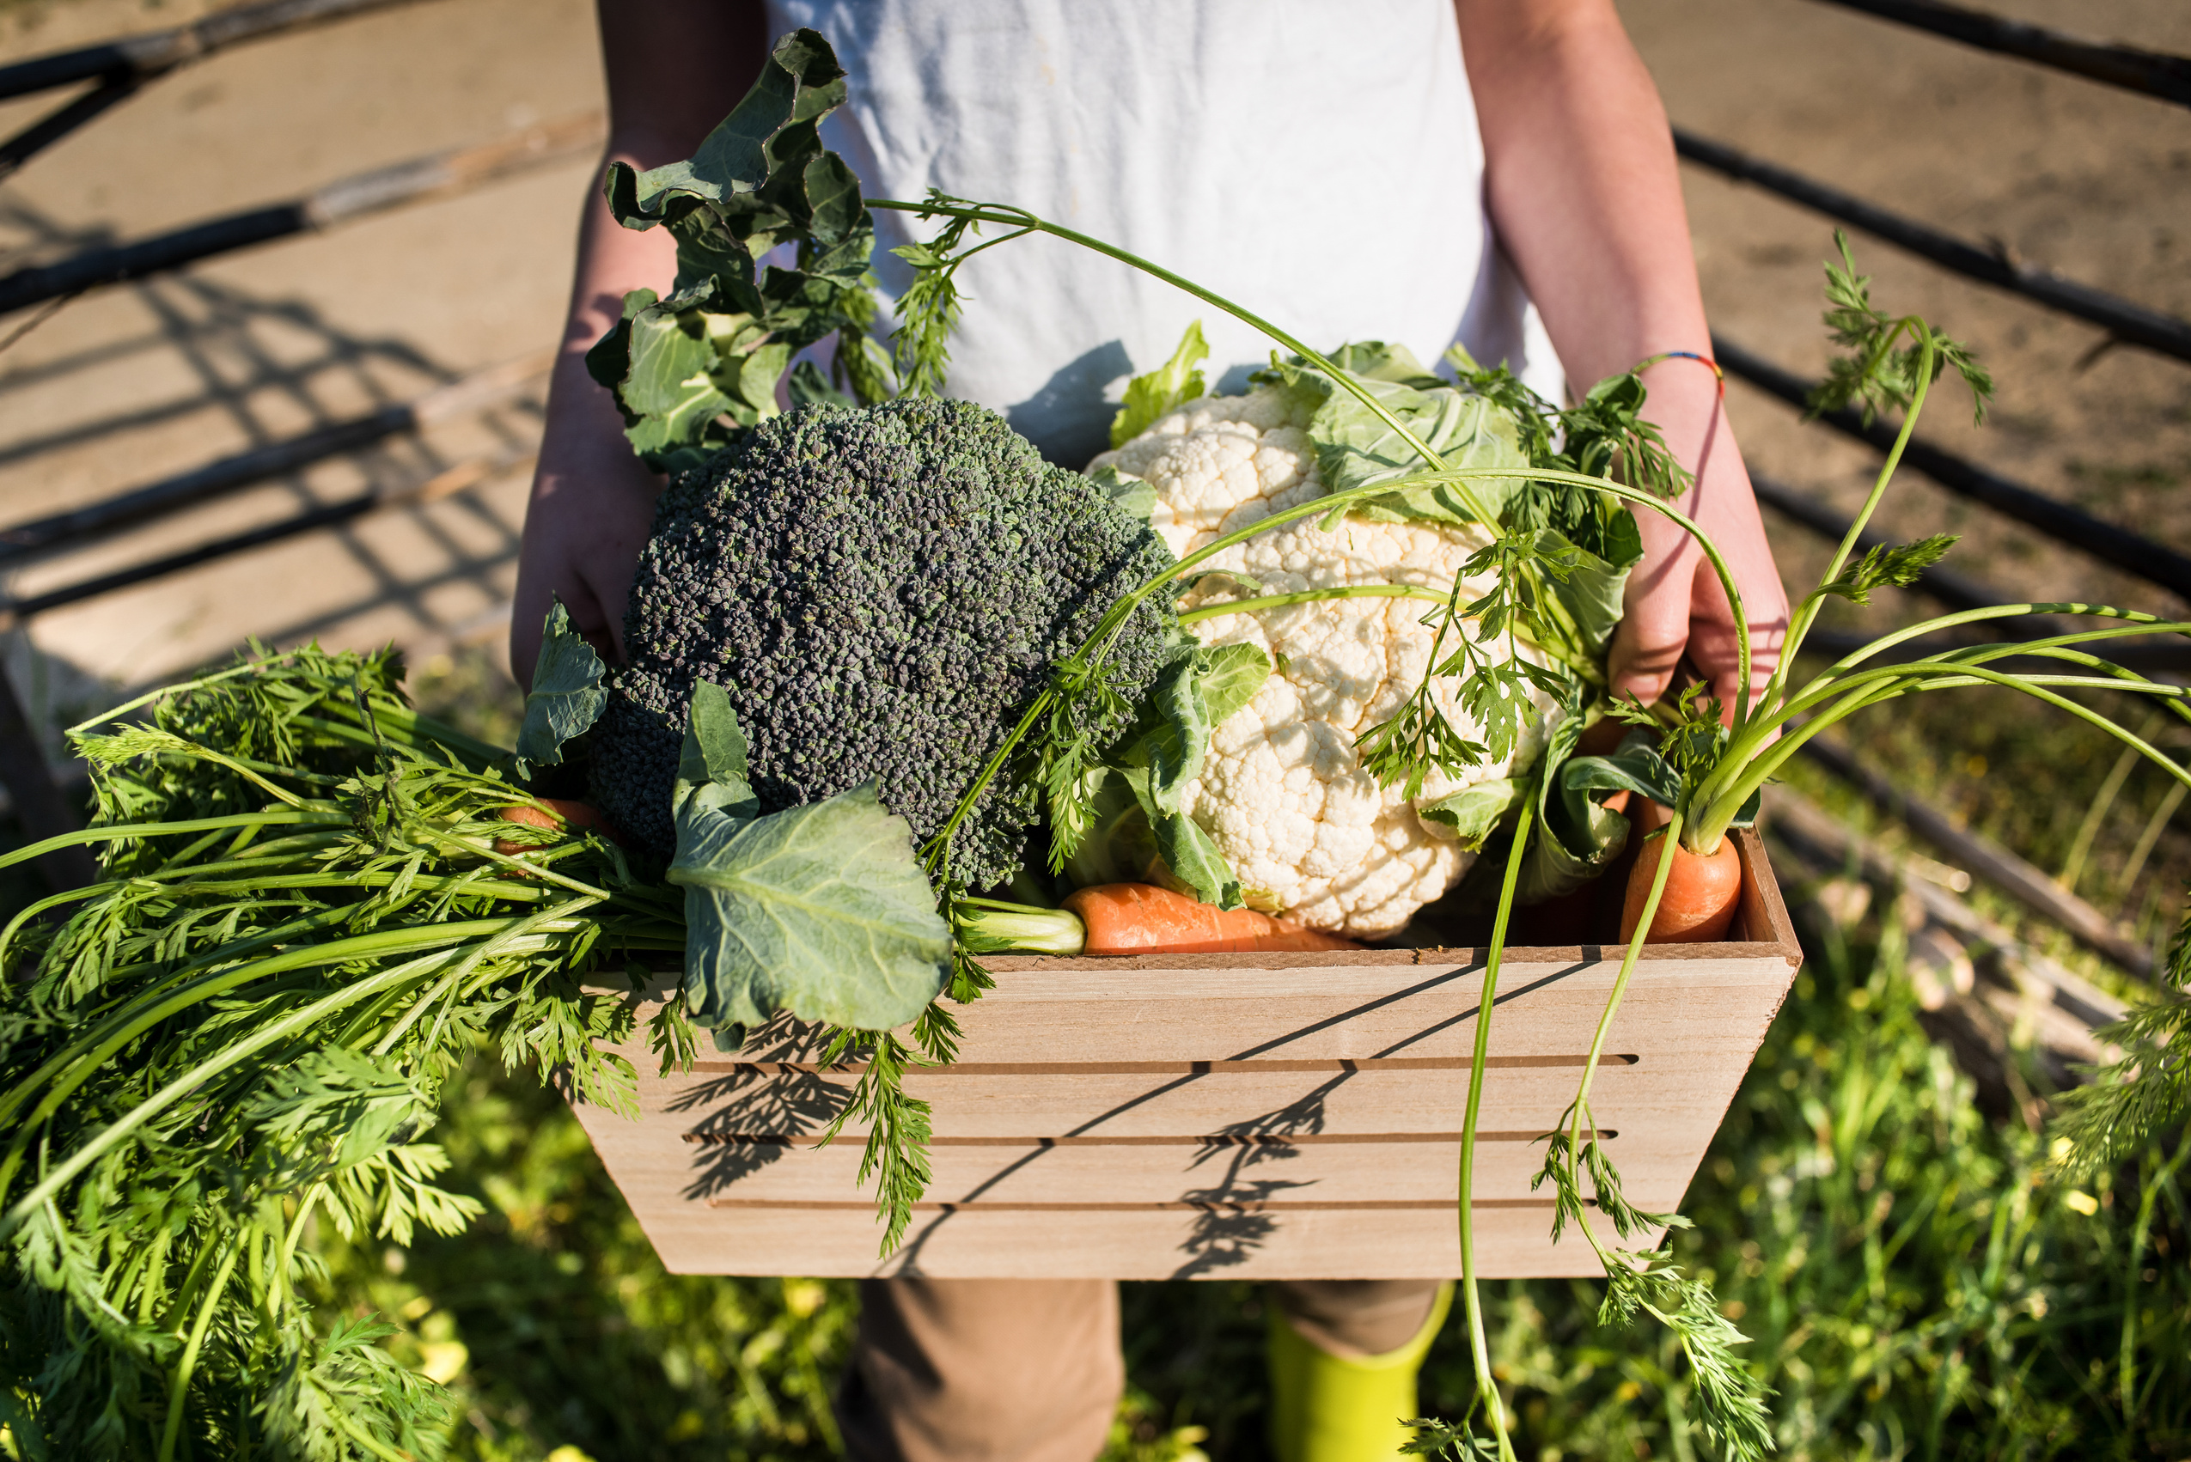
Objective
Optimize Land Utilization
Enhance Access to Agricultural Services
Enable Secure and Transparent Transactions
Increase Awareness of Government Schemes
Promote Collaboration in Agriculture
Ensure Data Management & Accountability

Slide 6
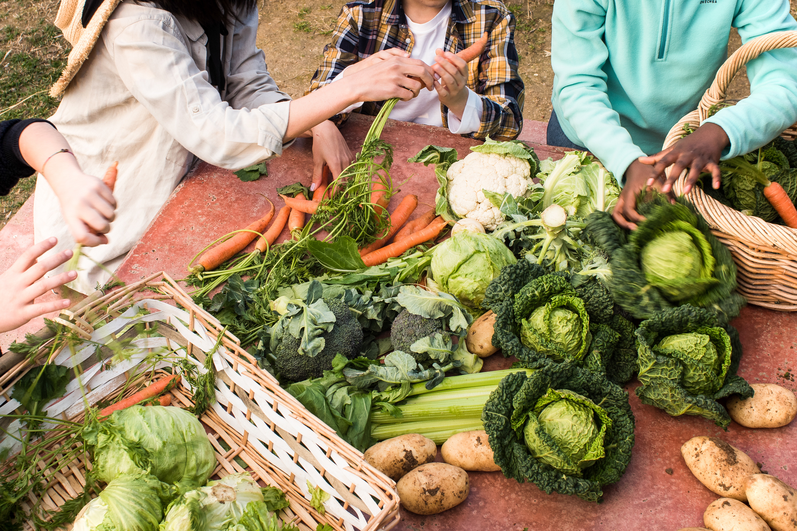
Proposed Solution
1 Web-Based Platform
2 Land Leasing & Rental System
3 Agricultural Services Marketplace
4 Government Scheme Information Center
5 Secure Payments & Digital Agreements
6 Data Management & Transparency

Slide 7
Benefits of the Platform
1. Benifits for Different Stakeholders
For Professional Farmers:
Easily lease or rent agricultural land for farming.
Access various farming-related services to enhance productivity.
Gain insights into government schemes for financial and technical support.
For Non-Professional Farmers:
Find opportunities to lease or rent their land to professional farmers or companies.
Utilize agricultural services for better farm management.
Get real-time updates on government schemes and subsidies.
For Service Providers:
Offer agricultural services such as equipment rental, soil testing, and consultancy.
Expand their reach to farmers and agricultural businesses.
Manage service requests and payments efficiently.

Slide 8
Unique Selling Proposition (USP)
Why Choose Our Platform?
1. Empowering Landowners (Non-Professional Farmers)
Enables landowners to lease their land efficiently and generate income without direct involvement in farming.
2. Seamless Land Leasing for Farmers
Farmers can easily find and lease agricultural land suited to their needs.
3. Comprehensive Agricultural Services
Access to a wide range of services, from soil testing to machinery rentals, ensuring productive farming.
5. Government Schemes Integration
Provides information on relevant government schemes and subsidies for farmers.

Slide 9
Revenue Model
Lease Commission Model
Charge a small commission on each successful land lease agreement between landowners and farmers.
Service Subscription & Commission
Partner with agricultural service providers and take a commission for every service booked via the platform.
Freemium Model for Users
Basic features for free, while premium users get advanced insights, priority listings, and better support.
Advertisement & Sponsorships
Allow agricultural businesses, seed providers, and equipment manufacturers to advertise on the platform.
Government & NGO Partnerships
Collaborate with government bodies and NGOs supporting agricultural initiatives for funding or grants.

Slide 10
Target Audience
Landowners (Non-Professional Farmers)
Individuals who own land but lack farming expertise and wish to lease it for agricultural purposes.
Farmers (Looking for Land)
Professional or aspiring farmers in need of arable land on lease to cultivate crops.
Agricultural Service Providers
Businesses offering soil testing, irrigation solutions, farm equipment rentals, and other farming-related services.
Government Agencies & NGOs
Organizations working to improve agricultural efficiency and sustainability.
Investors & Agri-Tech Startups
Entities looking to support or partner with tech-driven solutions in farming and land management.

Slide 11
Thanks
Tushar Amol Gaikwad

